Slide 1
Squeezing of quantum noise
Reducing quantum noise in an interferometer by adjusting the input state
Jinyuan Wu

Slide 2
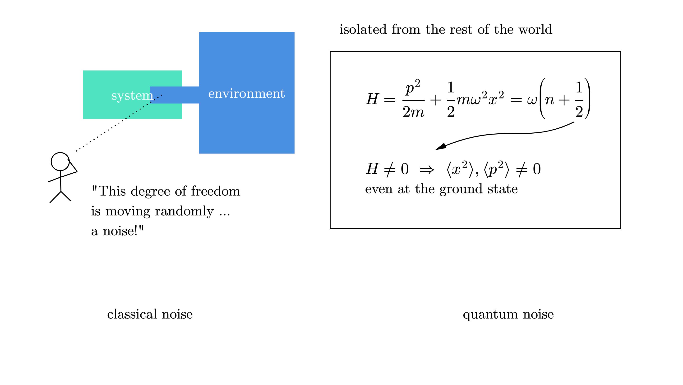
Introduction
Even when the system is isolated from the environment …
There is still uncertainty: quantum noise

Slide 3
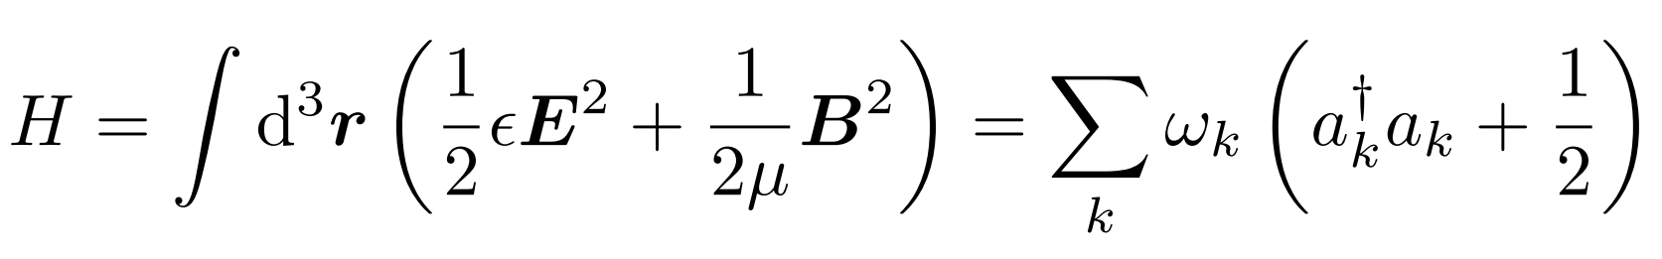
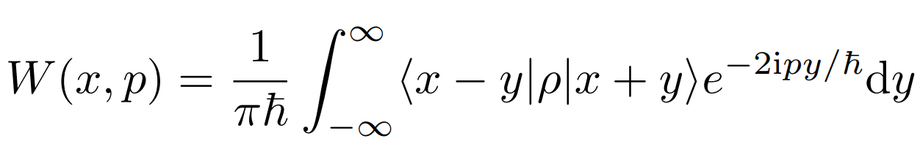
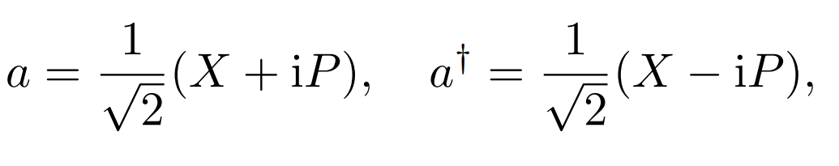
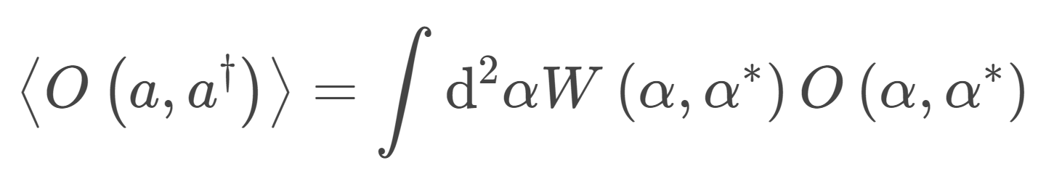
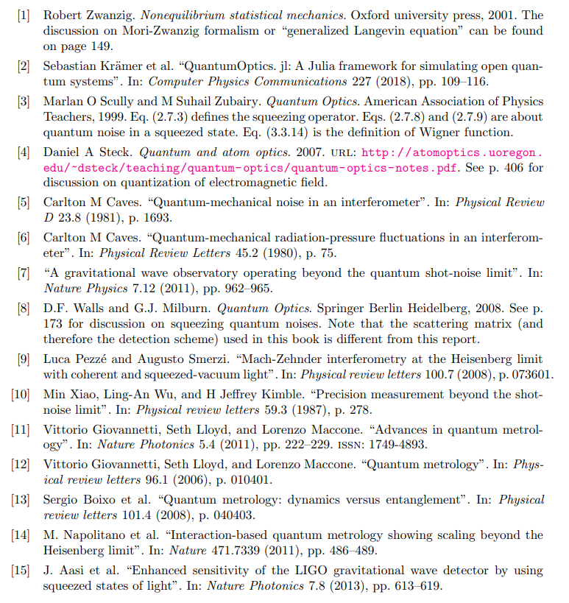
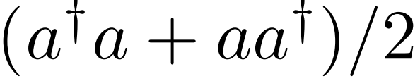
Visualize quantum noise
Quasi-probability distribution:
Wigner function
Consider only one mode
So that
Ordering:

Slide 4
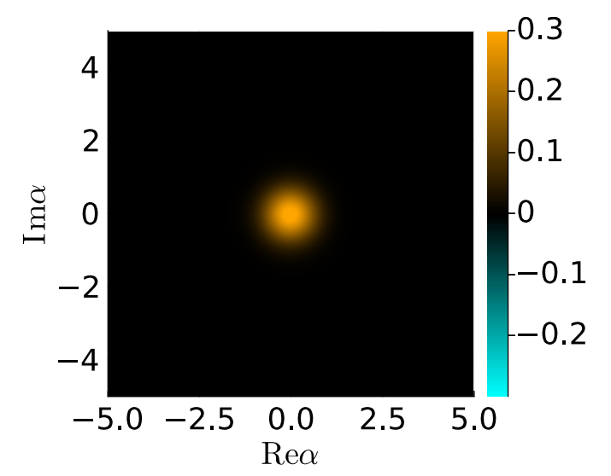
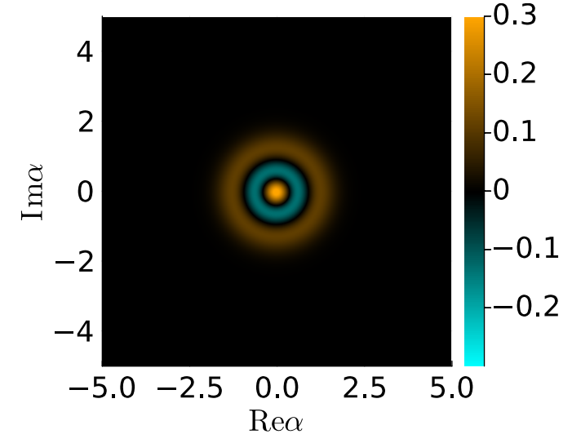
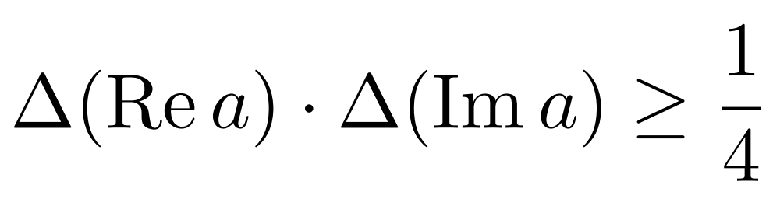
Visualize quantum noise
vacuum
N=2 Fock
negative: far from classical
blurred: uncertainty
Negative probability → n determined
→ phase completely uncertain
To find these Wigner functions: use QuantumOptics.jl

Slide 5
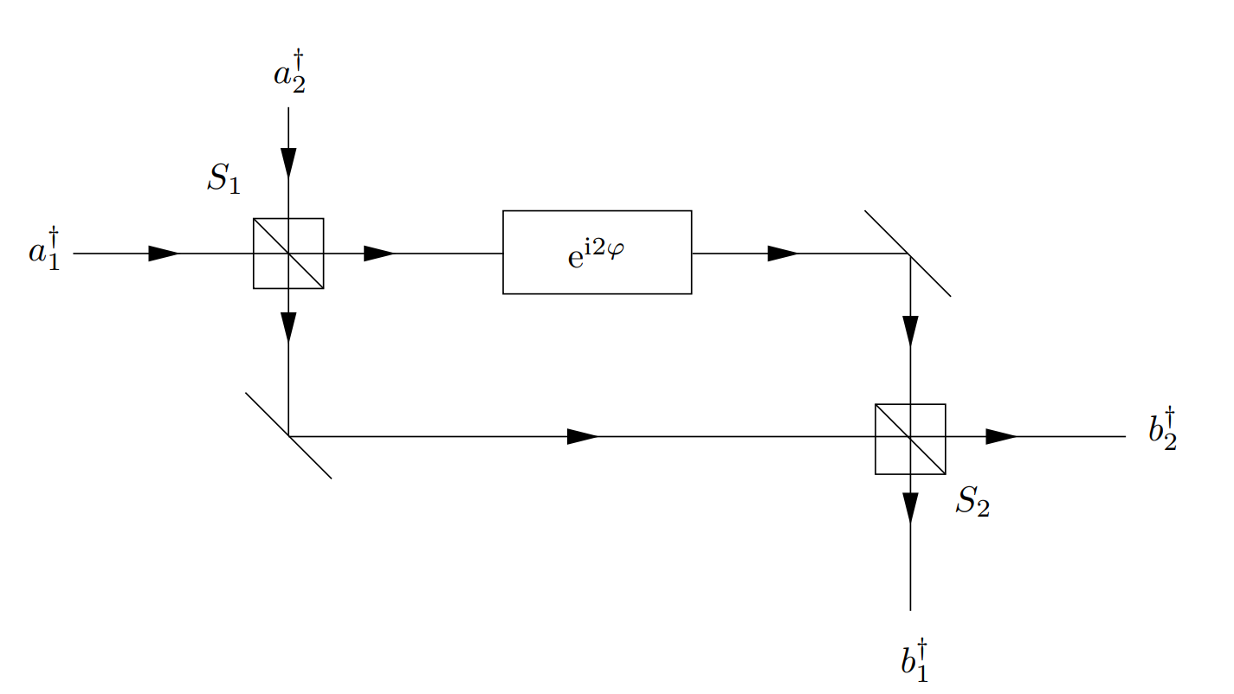
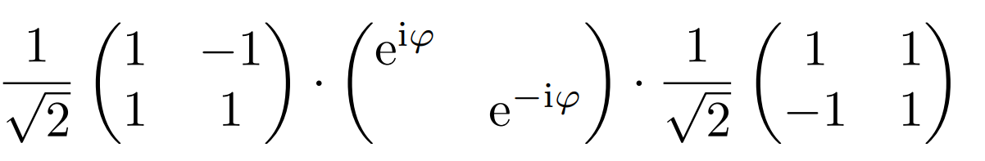
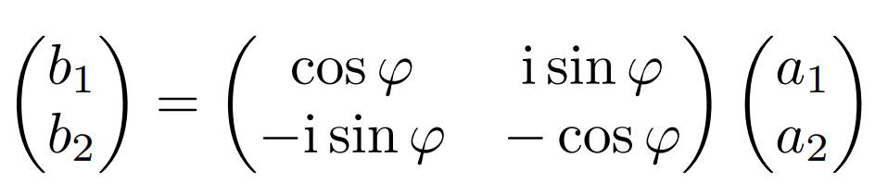

Mach-Zehnder interferometer
Dark port
Small angle;
material sample,
gravitational wave, etc.
Laser input:
coherent state
with parameter
α

Slide 6
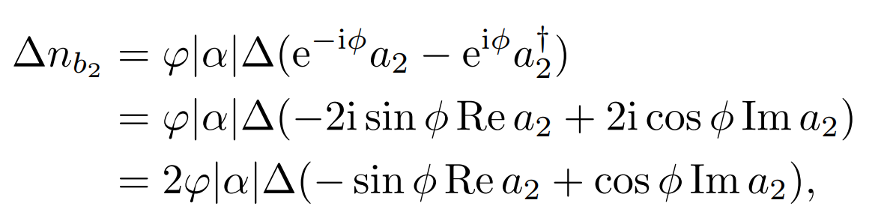
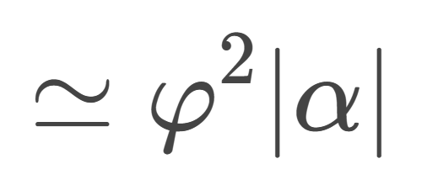
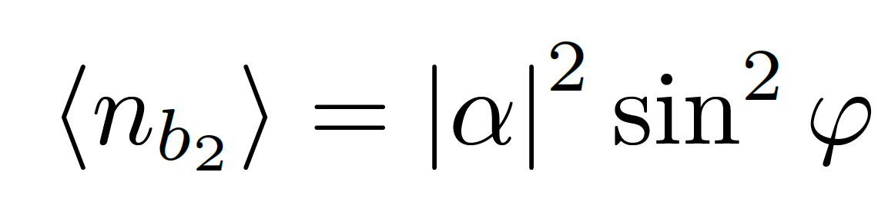
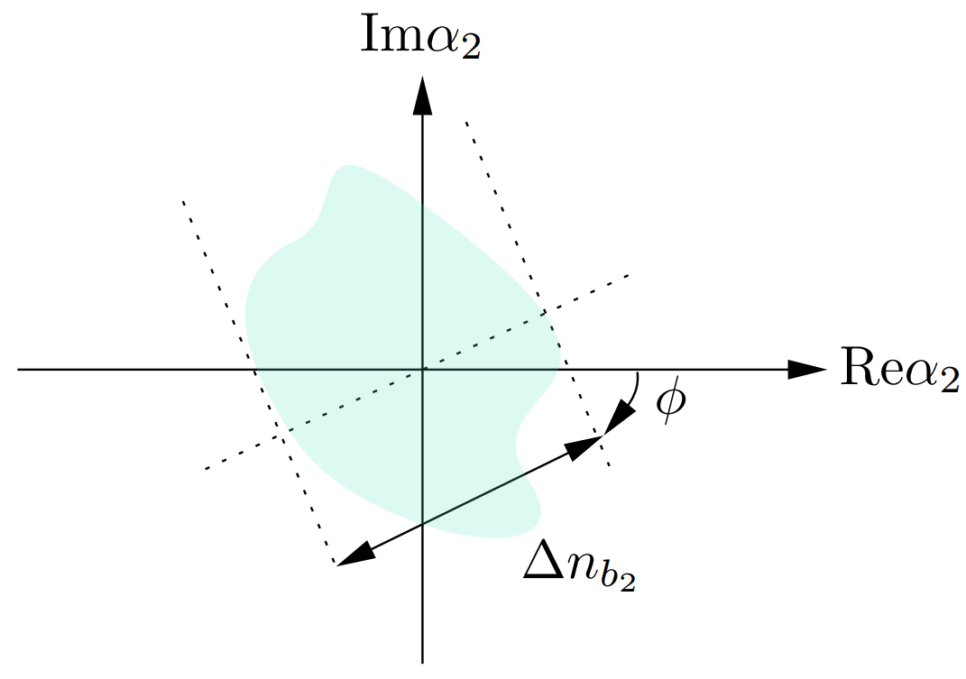
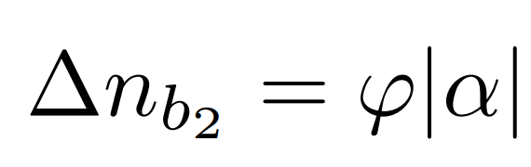
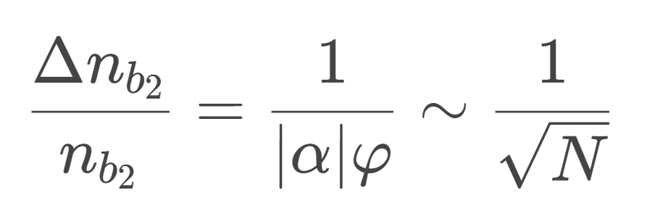
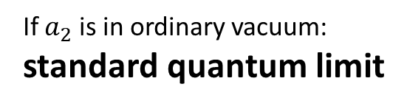
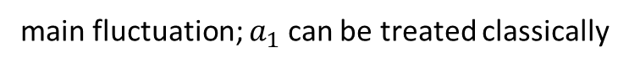
The origin of quantum noise
Main contribution,
but with small fluctuation
almost zero
main fluctuation; $a_{1}$ can be treated classically
If $a_{2}$ is in ordinary vacuum:
standard quantum limit

Slide 7
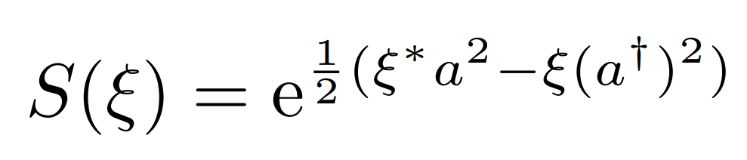
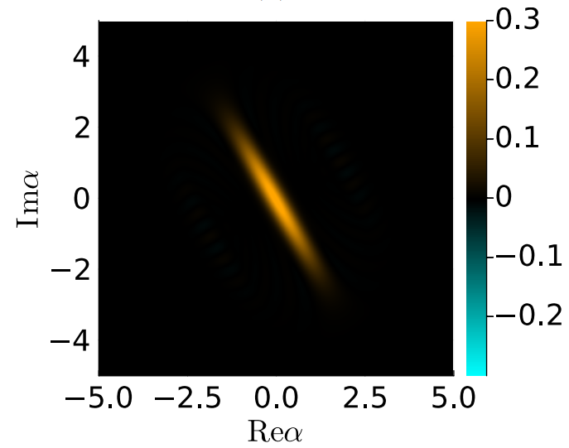
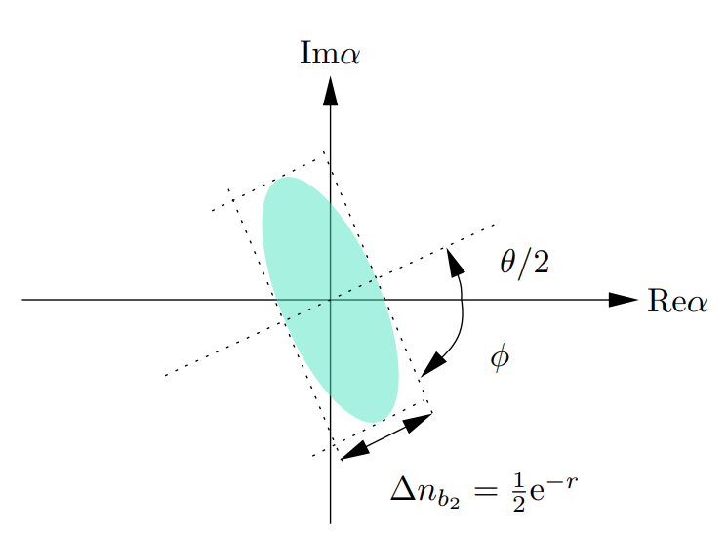
Squeezing the quantum noise
To reduce the quantum noise: squeezed the dark port vacuum!
Squeezed state
Squeezed state

Slide 8
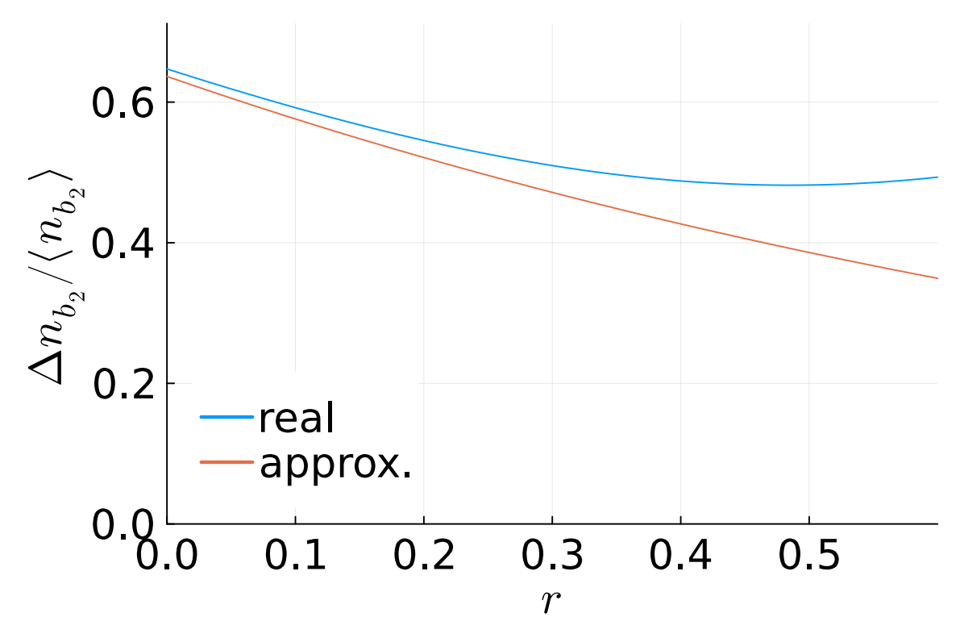
Squeezing the quantum noise
Unfortunately, if we squeeze the vacuum too much …
can no longer be ignored
Considering fluctuation of
Ignoring fluctuation of

Slide 9
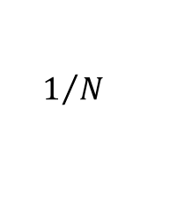
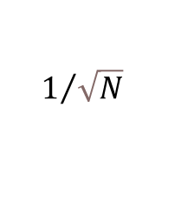
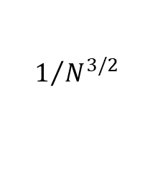
Discussion
Even better interferometry designs?
Standard
quantum
limit
Heisenberg
limit
“Nonlinear
measurement”
$$1/{\sqrt{N}}$$
$$1/N$$
$$1/{N^{3/2}}$$
M. Napolitano et al. “Interaction-based quantum metrology showing scaling beyond the Heisenberg limit”. In: Nature 471.7339 (2011), pp. 486–489.

Slide 10
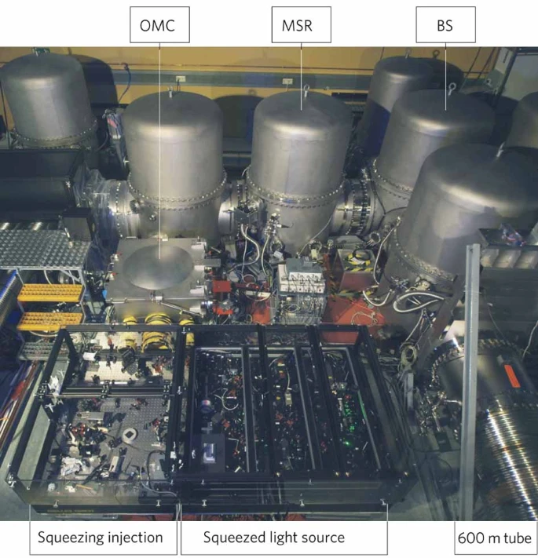
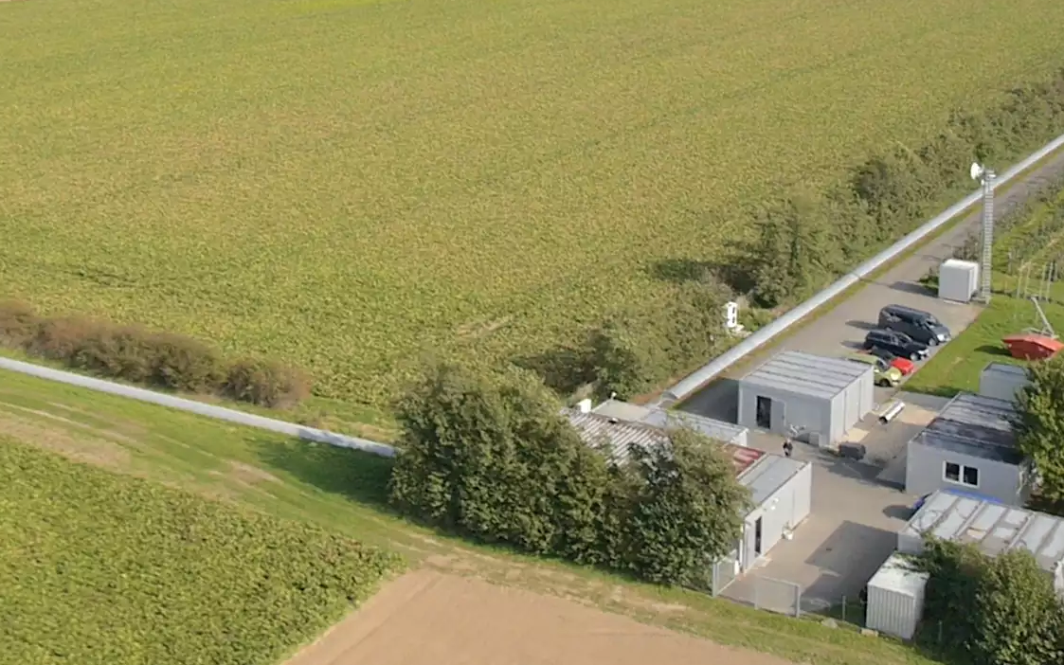
Discussion
BTW, this is not science fiction now
GEO 600

